Slide 1
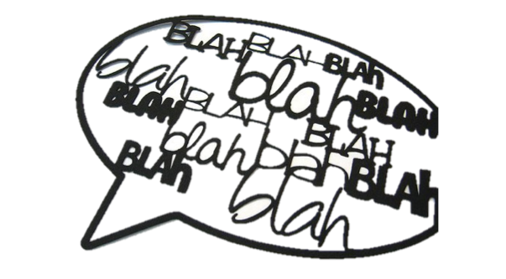



3-for-1: A touchscreen study used to look into bilingualism, social differences & lexical factors
Laia FIBLA REIXACHS
Charlotte MANIEL
Camila SCAFF
Alejandrina CRISTIA

Slide 2
Variance in language acquisition
All normally developing children eventually learn language
Nonetheless, there is some variance that could be useful to understand mechanisms of language acquisition. Two types studied here, both related to children’s language input:
Variance across children
Variance across lexical items

Slide 3
Variance across children (cont.)
In this talk, we’ll look at 2 factors that correlate with variance in input amount:
Bilingualism: It is likely that when spoken input is split into 2 languages, there will be a smaller amount of each language
Socio-economic status: Previous work (disclaimer: mostly in US) suggests that mothers with lower education talk less to their infants

Slide 4
Variance across children (cont.)
In this talk, we’ll look at 2 factors that correlate with variance in input amount:
Bilingualism: It is likely that when spoken input is split into 2 languages, there will be a smaller amount of each language → PART ONE
Socio-economic status: Previous work (disclaimer: mostly in US) suggests that mothers with lower education talk less to their infants → PART TWO

Slide 5
Variance across children
Some children learn e.g. words more rapidly than others ← to a certain extent, this may be due to differences in amount of directed spoken input
Receiving directed input provides the child with opportunities to:
Learn words from experiences that are relevant, and therefore adapted, to him/her (Shneidman & Fernald, 2012)
Hear many words → practice being a fast processor → be better able to pick up on words heard seldom (e.g., Weisleder & Fernald, 2015)
Talk back → (a) practice & (b) elicit more directed input (e.g., Harkness, 1973)

Slide 6
Variance across words → PART THREE
Not all words are equally easy to learn
Abstract words are comprehended later than concrete words (Bergelson & Swingley, 2013)
Words frequently heard in isolation are reportedly comprehended earlier (Brent & Siskind, 2001)
Differences across word classes - e.g., in English, nouns produced (accurately) earlier than verbs; no such difference in Korean (e.g., Goldfield & Reznick, 1990; Choi & Gopnik, 1995)

Slide 7
PART ONE: BILINGUALISM

Slide 8
Previous work: Monolinguals and bilinguals
Bilinguals receive a smaller amount of input, they are exposed to sounds belonging to (at least) two languages.
Delay in the discrimination of phonemic contrasts?
Yes (Sebastián-Gallès et al., 2009)
No (Burns, 2007)
Some phonemic contrasts follow different patterns of acquisition at the same age (Bosch et al., 2003)

Slide 9
Previous work: Variance within bilinguals
Not all bilinguals are made equal:
Probably many sources of variance (e.g., frequency of language-switching or language-mixing, degree of accentedness of parents…)
One of these factors: cross-language overlap
Different language pairs, similar realisations of phonemic contrasts, better discrimination (Havy et al.; 2015)
Two bilingual groups:
contrast present in both languages: French - Italian
contrast just in one language: French - Chinese
Same language pair: some phonemic contrasts are easier to acquire when present in both languages (Sebastián-Gallès et al., 2009)
Catalan - Spanish /e/ - /u/

Slide 10
Our goal
Sebastián-Gallés (2003) on /s/-/z/ voicing contrast by Catalan - (where /s-z/ exists), Spanish-learners (where it does not) & bilinguals
At 4 & 12 months monolinguals can discriminate the contrast
At 12 months, bilinguals cannot (delay)
Question 1: Are French monolingual 2-year-olds sensitive to /s/ - /z/ (phonemic contrast)?
Question 2: Does performance differ between monolinguals and bilinguals (French + another language)?
Question 3: Do bilinguals’ performance vary depending on whether or not L2 also has /s/-/z/ contrast?
Notes:
Sebastián-Gallés (2003) study /s/ - /z/
This contrast is present in Catalan but not in Spanish
12 months -> discrimination on monolinguals of Catalan and monoliguals Spanish
12 months -> no bilingual discrimination : maybe due to input exposure, ambiguous, Catalan has the contrast but not Spanish.

Slide 11
Participants
Data gathering: three nurseries from Paris
Sample Size: N = 51
Age 1.9 to 3.3 years old (mean age = 2.77)
Questionnaire returns: n = 48 families
Language exposure had been filled in by n =40
Classification criteria:
Due to missing questionnaire data, secondary (admittedly rough) classification:
Crèche #3 has a lot of missing questionnaires AND a higher proportion of bilinguals versus Crèches 1 & 2 that can be viewed as monolinguals
Monolingual: main exposure of French and < 10% other language(s) (n = 17)
Bilingual: exposure to French and > 10% other languages (n = 23)

Slide 12
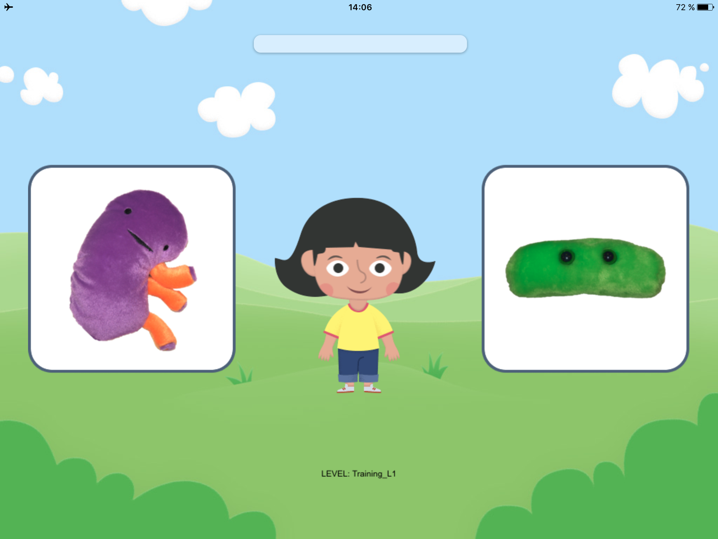



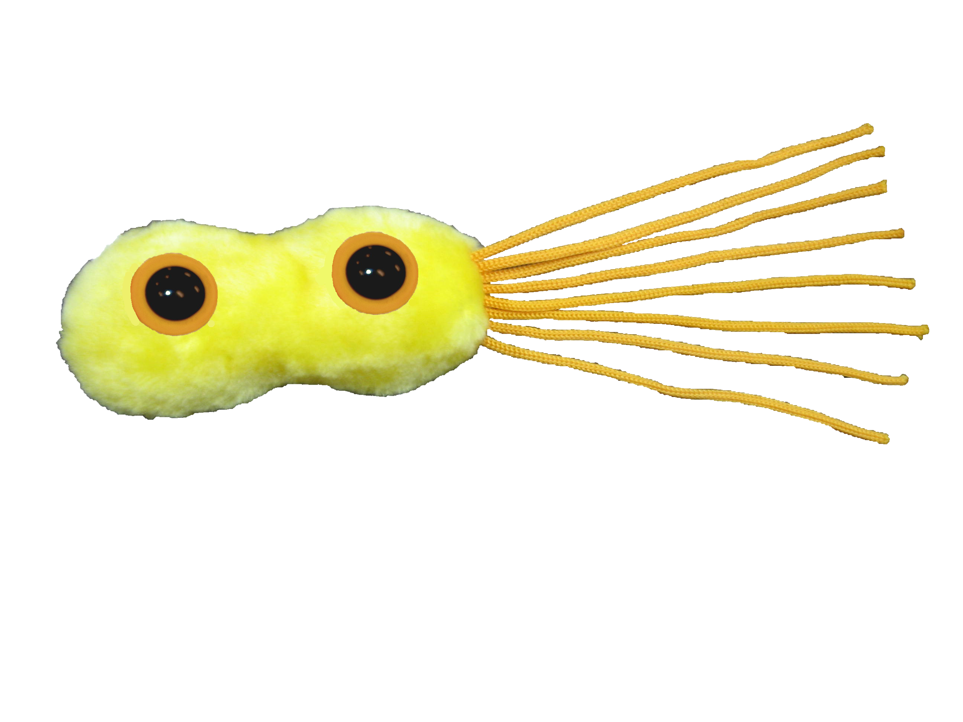
Stimuli
Animated Novel-objects
Non-words: monosyllabic, contrast initial
Fricative Voiced Contrast | /s/ | /z/
Training | /syl/ | /zyl/
Test | /sat/ /sop/ | /zat/ /zop/

Slide 13
Procedure
Phase I: Warm-up
Play “pop the bubble” game
Phase II: Training
3 trials with known words → repeat until correct answer
1 novel word “set”* → do not repeat
Phase II: Test
41 French pairs (for SES study - more below)
+ 3 novel words “set”*
* Explained in next slide

Slide 14
Each novel set is a triad of events:
Touche le sop !
Learning Phase
Testing Phase
Touche le zop !
Touche le zop !

Slide 15
Predictions
Significant discrimination score among monolinguals
Better performance in monolingual (bigger amount of input and more consistent) than bilingual children (smaller amount of input from each language and ambiguous)
Better performance in bilinguals whose L2 also has the fricative voicing contrast

Slide 16
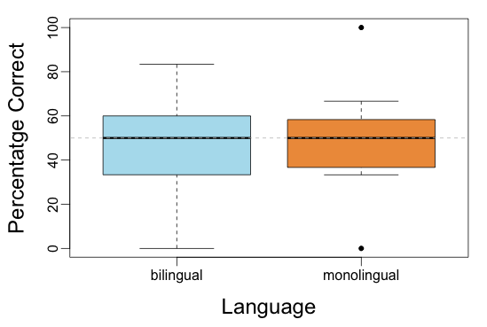
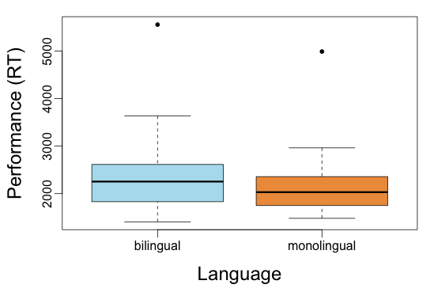
Results questions 1 & 2 (question 3 is moot)
Bilinguals (n = 23); monolinguals (n = 17)

Slide 17
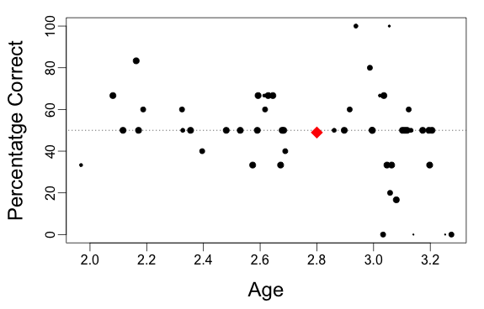
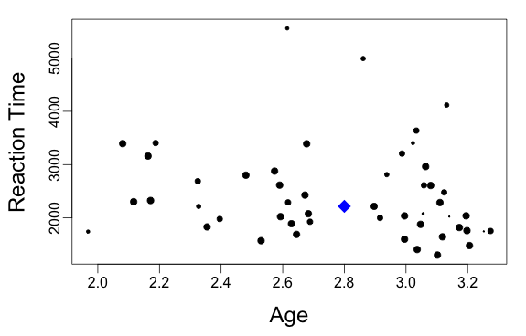
Would there be hope if focusing on older children?
Min age: 2.55, Max age: 3.27; Mean: 2.77

Slide 18
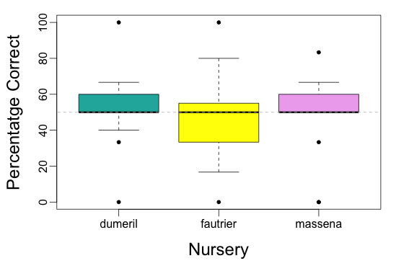
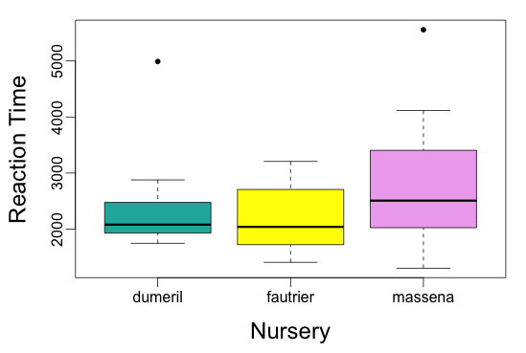
Power issue? Using nursery as a proxy for bilingualism
Crèche 1 (n = 14); Crèche 2 (n = 19); Crèche 3 (n = 18)
1
2
3
1
2
3

Slide 19
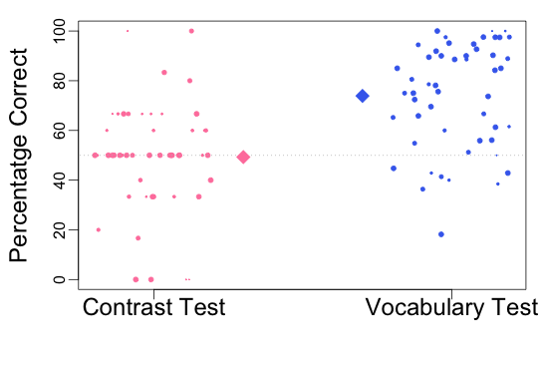
Are children unattentive?
Comparison of performance between vocabulary test and contrast test (n = 51)

Slide 20
Potential interpretations & future work
Contrast not acquired yet at that age?
Unlikely: 12-month-olds can detect the contrast in other studies (Sebastian-Galles, 2003; Cristia, 2011)
Task too difficult?
Several pairs have to be learned with basically one (boring) presentation → focus on a single pair, use a video with a small story
Context effect: Seemed very difficult to children in comparison with French word trials → do not mix trials
How can some infants be lower than chance (even at 0!)? → Strategies?

Slide 21
PART TWO: SOCIO-ECONOMIC STATUS

Slide 22
Previous work: SES effects
SES effects on language in US populations (Hart & Risley, 1995 and many others) However, extensions to other cultures do not always confirm strong differences in language across kids
For instance no particular SES effects among Mexican Spanish-learning children (DeAnda et al., in press; Jackson-Maldonado et al., 2003, …)
Often, variability in SES within a paper is very small
Perhaps effects are not linear or stable throughout SES range
Perhaps SES interacts with a range of factors
← e.g., Lack of SES effect in Mexican Spanish samples has been attributed to “protective quality of caregiver beliefs” - mostly due to low within-group variance in the importance attributed to child speaking (both high & low SES moms would give it little importance)
Notes:
(most participants on the low end, or most participants in the middle range)
SES 3 parameters

Slide 23

Our research question
Does caregiver SES correlate with the lexical development of young children (2-3yo) in France? Little data in France (EDEN cohort, cf. Peyre et al., 2012)
Like the United States, high gross national product
Unlike the US, a great deal of support to lower SES families + wide-spread use of daycare facilities --> developed a French vocabulary test, on a touch-screen support
Notes:
We saw that there are many ways in which SES should matter, so it would be expected huge effects ensue EDEN cohort : 1002 children, the goal is to identify biological and social factors that predict changes in language skills between the ages of 2 and 3 years. (Exposure to alcohol during pregnancy, earlier birth term, lower level of parental education and lower frequency of maternal stimulation were associated with the declining trajectory. Breastfeeding)

Slide 24
Why a touchscreen study? The Computerized Comprehension Task (CCT)
A touch-screen vocabulary test
Developed in English & adapted to French & Spanish
Measured : accuracy, immediate test-retest reliability, convergence with parental reports, prediction of production 1 year later
Overall, variable accuracy, good reliability and convergent validity, & greater predictive power than parental checklist (Friend & Zesiger, 2008, and ff.)
One caveat: stimuli based on words chosen from the MacArthur Communicative Development Inventory (parental checklist) ← driven by production → We can do better!

Slide 25
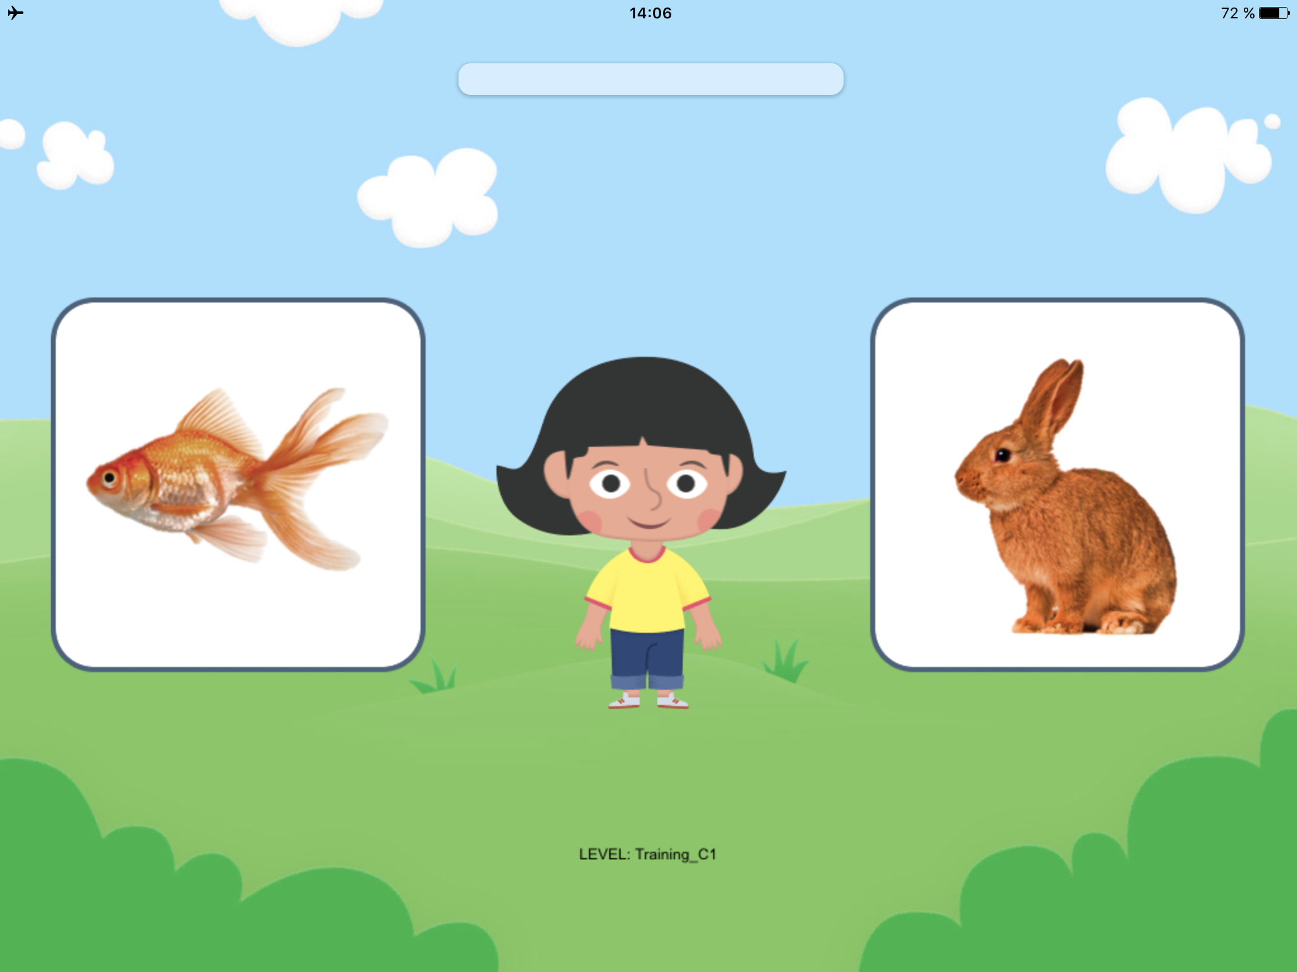
Procedure: Same as Part one
Phase I: Warm-up
Play “pop the bubble” game
Phase II: Training
3 trials with known words → repeat until correct answer
1 novel word “set” → do not repeat
Phase II: Test
41 French pairs in pseudo-randomized order (with constraints on side of target & difficulty level repetition)
+ 2 novel words “set”
Important! Objects appear silently so word names are *not* introduced before the test prompt!!!

Slide 26
Stimuli
3 training pairs + 41 test pairs (following CCT):
Three word types:
22 nouns (“Touche le ...”)
11 verbs (“Touche celui qui …”)
8 adjectives (“Touche la …”)
Varying in difficulty*:
⅓ easy
⅓ moderate
⅓ difficult
* Our definition of “difficulty” is not the same as CCT’s!
Frequency in French CHILDES (1-3y) | Easy | Moderate | Difficult
Nouns | 1800 → 200 | 200 → 100 | 100 → 3
Verbs | 1000 → 100 | 100 → 30 | 30 → 4
Adjectives | 1100 → 200 | 200 → 25 | 25 → 3
Notes:
Part I
a) Protocole
To have an idea of individual differences in terms of vocabulary, we designed a test with 41 words asked in total. The test duration was 10min (no more longer because of the age of the children). Some researchers in Argentina are doing a similarly test, and they chose words known by all children 2-3 years old in all the SES. As them, we had to select 3 word types (nouns, verbs and adjectives) and 3 word levels (easy, moderate and difficult). The difficulty of a word depends on its occurence, namely its frequency of apparition. To find the occurence of our words, we used the CHILDES french corpus, using only the records of 2-3 years old children. Then we defined the boundaries in terms of word type and word level [as we see in this table] . We tried to have the max of words in common with the Argentine test, but the difficulty level was not always the same in French and in Spanish. So to complete the missing words, we match items in term of gender [for example here “le poisson” and “le lapin”], animacy [here 2 animals] and complexity and the color of the pictures [here orange-brown and no background]. The items were showed by pairs. The difficulty levels were mixed to have data for all the conditions for each child. The side of apparition of the item asked was determined randomly. We had 2 lists to counterbalance all of that : in the first one we asked for an item, and in the second we asked for the other item of the pair. In order that all children have the good gesture to touch the items, we first played at a first funny game where the child had to burst bubbles with his finger. Once the child has the right gesture, we change the game and start with a training phase so that the child understands the setpoint, then the real test begins.

Slide 27
Participants (same as in Part One)
Initial N = 51 infants but 48 questionnaire returned
10 questionnaires had no answer to the question on SES → N = 38 5 did not have at least 9 trials so excluded for main analyses → N = 33 9 did not have at least 4 trials by trial type → for some follow-up analyses, N = 29
Classification criteria : In the questionnaire we asked for years of education and the occupations of the 3 caregivers → Our SES measure: Mother’s years of education (most commonly used in previous language literature - e.g., Huttenlocher et al., 2010; Rowe, 2004; ...)
Notes:
*because in others studies it has been show that it is the most predictable parameter ofthe child's vocabulary
In the questionnaires we ask for occupations and level of education of the 3 cargivers (we lack the income, it is frowned upon to ask in France)

Slide 28
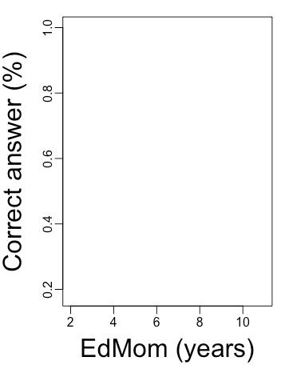
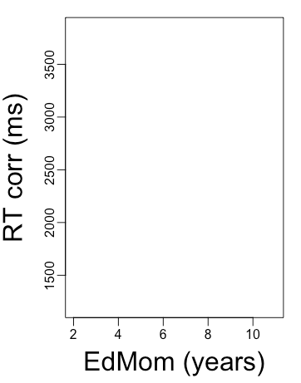
Predictions main hypothesis
Notes:
Part I
b) Predictions
Our predictions were a positive trend between the percentage of correct answers and the education of the mom and a negative trend between the response time and the mom education.
In other words, the higher the education level of the mother, the higher the percentage of correct answers and the greater the response time is short.

Slide 29
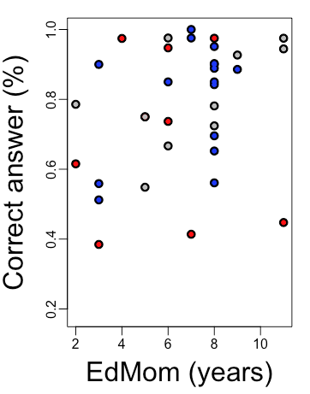
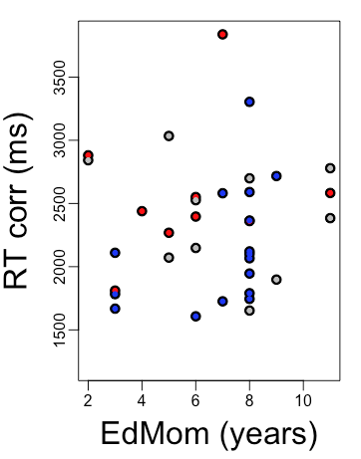
Results main hypothesis
N=33
Creche 1 (n=10) Creche 2 (n=15) Creche 3 (n=8)

Slide 30
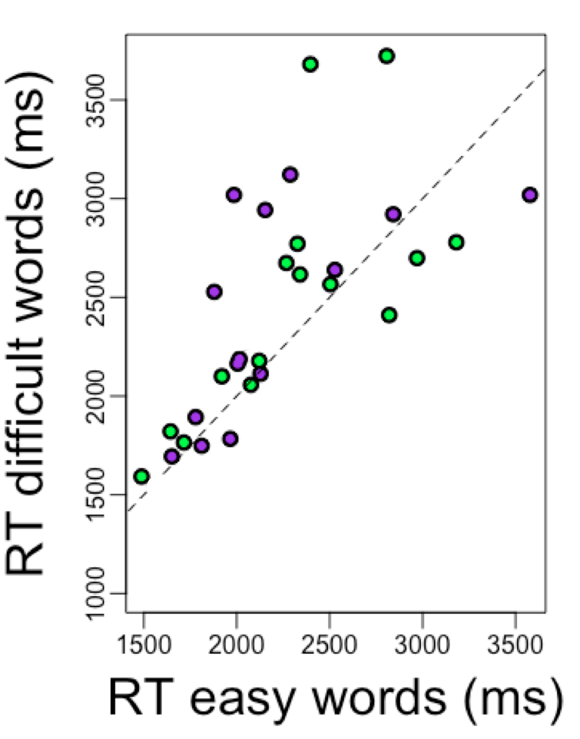
Additional results
N=33
N=29
Creche 1 Creche 2 Creche 3
Creche 1 (n=10) Creche 2 (n=15) Creche 3 (n=8)
High SES (n=15) Low SES (n=14)
Notes:
Part I
c) Some results
Now we can study in details the response time in terms of SES. Each point is a child.The children that respond as fast for the frequent words and the less frequent words are on the line. The children above the line respond slower for the less frequent words, and the children below respond slower for the frequent words. We supposed that in low SES the responses will be slower for the less frequent words, but it’s not really the case. Again we don’t have a real tendency.
So we do not find the differences in the lexic between the different SES that the researchers find in the USA.

Slide 31
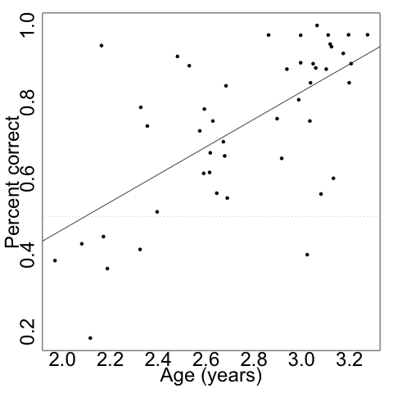
No relationship between maternal education & performance: Potential explanations
Are our outcome measures “bad” ? NO
Ceiling effect? NO
Floor effect? NO
Sensitive to variation in lexical items & participants
Notes:
Hollingshead’s index is a comprehensive measure of SES that includes 4 parameters whose the maternal education

Slide 32
No relationship between maternal education & performance: Potential explanations
Are our outcome measures “bad” ? NO
Ceiling effect? NO
Floor effect? NO
Is our predictor “bad” ?
Maternal education only ONE aspect of SES
Perhaps it would be appropriate to use other aspects (e.g., Hollingshead's index)
Might the correlation between maternal education & outcome be less strong, or appear later in France?
Notes:
Hollingshead’s index is a comprehensive measure of SES that includes 4 parameters whose the maternal education

Slide 33
Strengths, limitations, & future work
The test is sensitive:
Slower RT for difficult than easy items
Higher accuracy among older children
GREAT data collection: 97% of children were willing to play, mean # trials completed: 32/41
Problematic confound with language exposure & small sample size
Test in other Parisian creches to have more monolinguals -- but then they may vary less in SES
Test in less urban areas of France
Ongoing work: Similar test in Argentina, with populations widely varying in SES
But how big would we expect the effect to be → Meta-analysis of extant work might be necessary & samples may end up being too large…
Notes:
Test suitable for the children

Slide 34
PART THREE: LEXICAL FACTORS

Slide 35
Predicting success for individual lexical items
Scientific question: Can inherent properties of words predict later knowledge?
To answer this question: we focus on variance across lexical items collapsing across individual children
DISCLAIMER: We will use the touchscreen performance, which reflects not only children’s knowledge of the word but also ease of processing
Not relying on parent’s estimation of vocabulary knowledge of their children

Slide 36
Predictors studied in previous work
Input-Related Factors
Conceptual Factors
Concreteness
Babiness (Baby-talk-like-ness)
Iconicity
Valence (happy- unhappy)
Arousal (excited - calm)
Total frequency
Frequency in isolation
Mean Length of Utterances containing it
Phonotactic frequency
Not exhaustive!
Notes:
Phonotactic probability refers to the frequency with which a phonological segment, such as /s/, and a sequence of phonological segments, such as /s^/, occur in a given position in a word

Slide 37
Predictors studied in present work
Input-Related Factors
Conceptual Factors
Total frequency
Frequency in isolation
Mean Length Utterance
Phonotactic frequency
Burstiness
Concreteness
Babiness (Baby-talk-like-ness)
Iconicity
Valence (happy- unhappy)
Arousal (excited - calm)
Notes:
Phonotactic probability refers to the frequency with which a phonological segment, such as /s/, and a sequence of phonological segments, such as /s^/, occur in a given position in a word

Slide 38
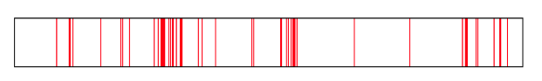
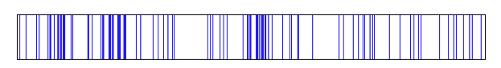
Burstiness
“Theory”
Frequency = 820
Coeff = 0.42
“Also”
Frequency = 820
Coeff = 0.85

Slide 39
Input … a CHILDES corpus
We don’t have the input of children who participated in the study → predictors will come from CHILDES (MacWhinney, 2000 )
Hypothesis: CHILDES’s French data represent “the true” values
Estimation of “innate lexical properties” of the words by collapsing interindividual data from hundreds of children
Corpus “France” → Lyon & Paris
= more than 500 recordings from children under 3yo

Slide 40
*MOT: Tu as vu le bateau ?
*CHI: yyy .
*MOT: Bateau .
*MOT: C’est un joli bateau .
GENERAL PIPELINE
Carried out for each lexical item in the tablet vocabulary test
Concreteness from English ratings = 4.87
Select adult speakers & clean comments
Frequency in isolation bateau = 1
*MOT: tu as vu le bateau?
*MOT: Bateau .
*MOT: C’est un joli bateau .
Global frequency bateau = 3
Clean punctuation
tu
as
vu
le
bateau
bateau
c
est
un
joli
bateau
Burstiness bateau = 0.36
tu
as
vu
le
bateau
bateau
c
est
un
joli
bateau
tu as vu le bateau
bateau
c est un joli bateau
Magic
One word per line
Measure inter-word interval
0
4

Slide 41
Analysis
Since predictors come from other sources, all children have the same predictors for a given word → non-independence of predictors
So how can we calculate potential association?
First rough approach:
For each child:
“Correct” vector= all the words he/she was accurate on
“Incorrect” vector= all the words he/she was NOT accurate on
→ enter each predictor’s data for that child into Welch’s test (not paired because number correct & incorrect may not be the same) → extract t-value for that child
For the population of children: boxplots over t-values within each predictor

Slide 42
Predictions
Global frequency | Correct > Incorrect → positive t
Frequency in isolation | Correct > Incorrect → positive t
Concreteness | Correct > Incorrect → positive t
Burstiness | Correct < Incorrect → negative t

Slide 43
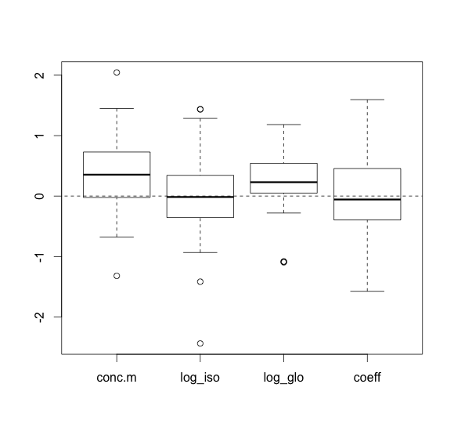
Prediction of lexical features across children (Preliminary Results!!)
concreteness
isolation
global
burstiness

Slide 44
PRO
CONS
3 simultaneous studies
Great data collection
Easily applicable to other languages
Children’s own answer and not estimation from parents
Bypassing the lab
and test understudies populations!!
Rely on the feed-back of questionnaires
Because of the support hard to test other Word categories
Age of implementation

Slide 45
Discussion & future directions
Looking effect of the predictors across difficulty of the given word
Looking effect of the predictors across Word Category
Estimating the weight of each predictor by SES
Expanding this work to Spanish (ELEAC project)
Only, for nouns, adjectives or verbs

Slide 46
We thank :
Participating families
Creches staff
Anne-Caroline FIEVET

Slide 47

Thank you!
We thank :
Participating families
Creches staff
Anne-Caroline FIEVET

Slide 48
More material

Slide 49
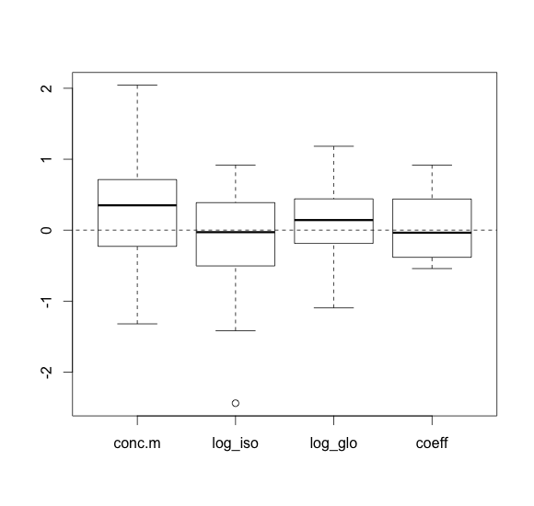
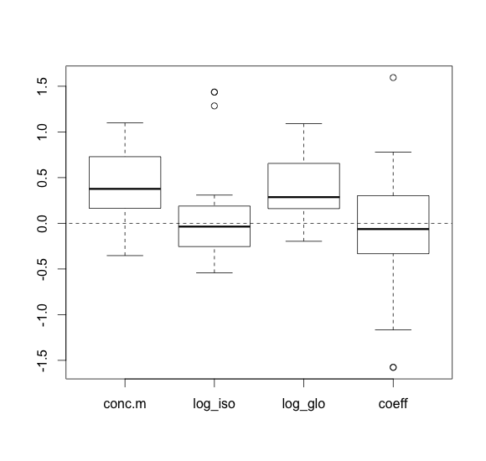
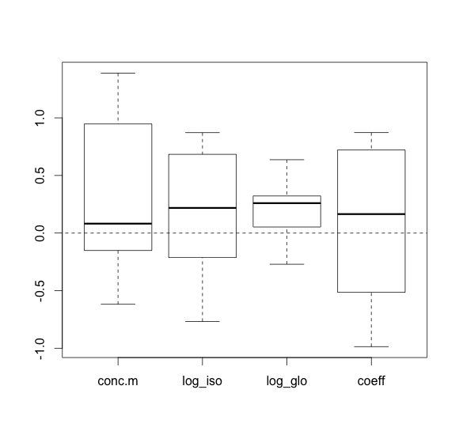
“Creche 3”
“Creche 1”
“Creche 2”

